Slide 1

Advancing Biofuel Production with Pyrolysis and Gasification – Integrating the benefits of Carbon Capture and Hydrogen Production
BioTheRoS Online Webinar, 12th May 2026
Moderation: Andrea Sonnleitner (BEST)
Speakers: Patrick Reumerman (BTG), Doris Matschegg (BEST), Philipp Graefe (BEST)
The BioTheRoS Project has received funding from the European Union’s Horizon Europe research and innovation programme under Grant Agreement No. 101122212.

Slide 2
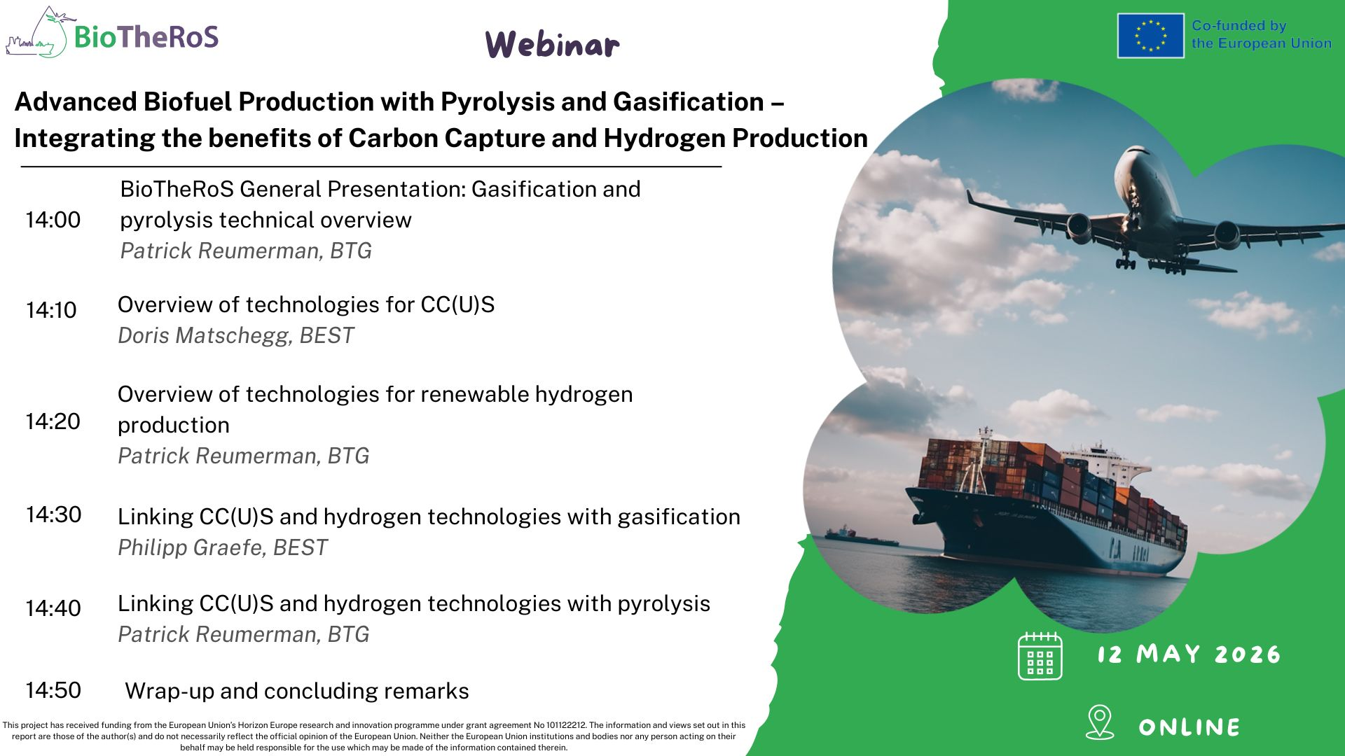

Slide 3
BioTheRoS General Presentation: Gasification and pyrolysis technical overview
Patrick Reumerman, BTG

Slide 4
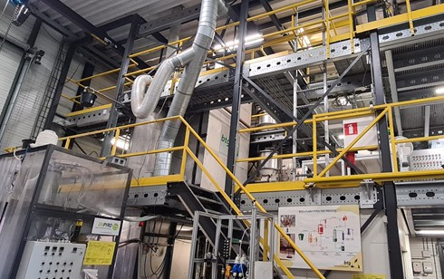
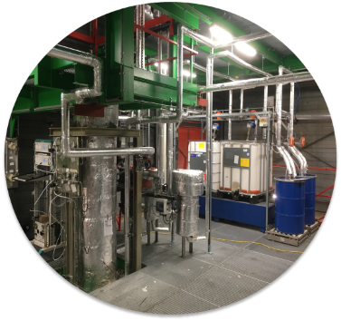






BioTheRoS Overview
Project Details
BioTheRoS is an EU Horizon Programme under Grant Agreement No 101122212 running from 2023
Consortium Members
Demonstration Cases
Application in pyrolysis and upgrading units in Netherlands & gasification unit in Austria
4

Slide 5






BioTheRoS Objectives
BioTheRoS develops innovative & cost-competitive Fast Pyrolysis-to-biofuels and Gasification-FT-Synthesis value chains, combining Carbon Capture Utilization (CCU) and fuel upgrading for accelerating the scale-up of sustainable biofuels.
BioTheRoS Goal: Transfer biomass into an opportunity
1.
Development of cost-effective & sustainable technologies for thermochemical conversion of biomass to produce biofuels to TRL5
2.
Selection and assessment of several biomass feedstocks suitable for scaled-up sustainable pyrolysis & gasification biofuel value chains employing predictive biomass demand AI models
3.
Development of scale-up rules of biofuels production based on advanced modelling techniques and lab/pilot-scale trials.
4.
Development of an LCSA framework, integrating technical, environmental, economic & social parameters via multi-criteria decision analysis techniques
5.
Identification of concrete measures to improve the sustainability of thermochemical conversion of biomass to biofuels via pyrolysis and gasification
6.
Provide clarity into the market dynamics of scaled-up pyrolysis and gasification biofuel value chains
23/10/2025

Slide 6
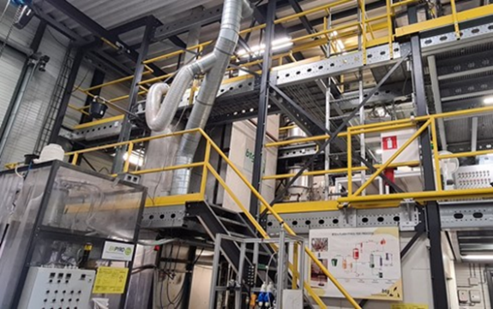
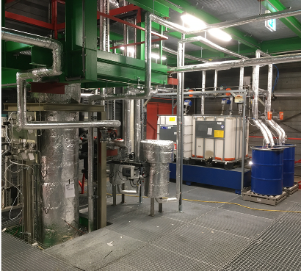
Demo sites & related technologies
The Netherlands – Pyrolysis and Upgrading units
Pyrolysis Units:
Bench-scale unit: 2–5 kg/h
Pilot plant: 80–200 kg/h
Upgrading Unit (for pyrolysis oil to fuels):
Continuous operation
Capacity: 0.8–1.5 kg/day
Austria – Gasification Unit
Gasification Units:
1 MW DFB reactor: ~200 kg/h feed rate
250 kW Fischer–Tropsch pilot unit: produces 15-20 L of FT raw product
Upgrading Unit (for FT waxes to fuels):
Hydrocracking pilot plant located in Greece
23/10/2025

Slide 7
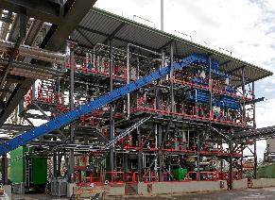
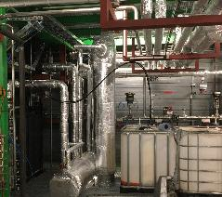
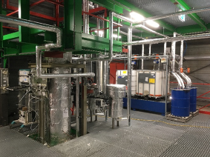
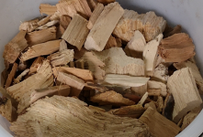
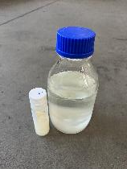
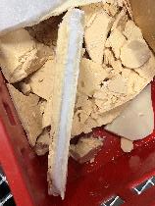
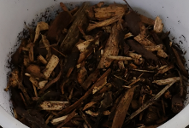
Gasification – transport fuels value chain
Gasifier
Fine gas cleaning
FT-synthesis
Wood chips
FT raw product
Forestry residue
Full Gasification value chain operation
Gas production
Gas cleaning
Synthesis
The full value chain was succesfully demonstrated.

Slide 8
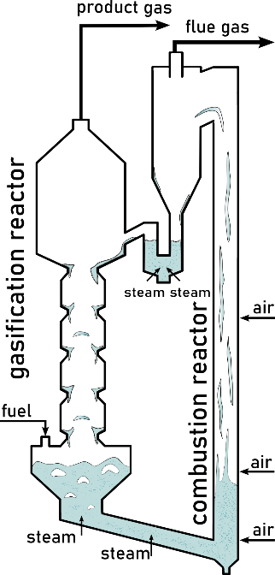
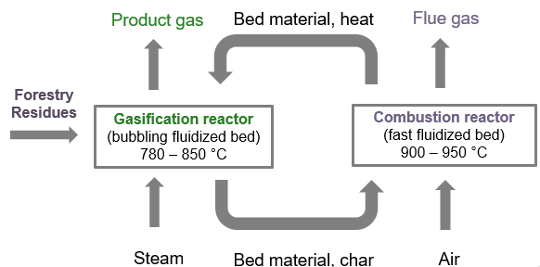
Gasification – Dual fluidised Bed technology
2%
H₂
CO
CO₂
CH₄
C₂H₄
Separation gasification and combustion means no nitrogen in syngas, and a very high quality (high H2 content)

Slide 9
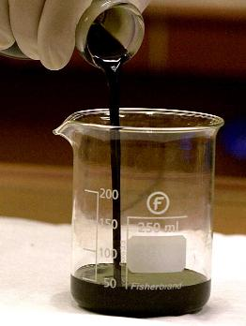
Fast Pyrolysis Value Chain
Biomass
Fast Pyrolysis
FPBO
Hydrotreatment
HPO
Distillation
Advanced biofuels
Fast
Pyrolysis
Reactor
T ~ 500°C
Oil
Condensor
T ~ 20 – 50 °C
Fuel gas
Biomass
Organic Vapour
Pyrolysis Oil
Water content
Density
LHV
Acid Number
Sulfur
FlashPoint
Cetane Number
MCRT
25
1,170
16
70
< 0.05
?
< 20
> 15
wt%
kg/m³
MJ/kg
mg_{KOH}/g
wt%
°C
-
wt%
Sand & char
Sand
Char
Combustor
T ~ 550°C
Air
Flue Gas
Ash
Simplified representation of BTG’s pyrolysis process

Slide 10
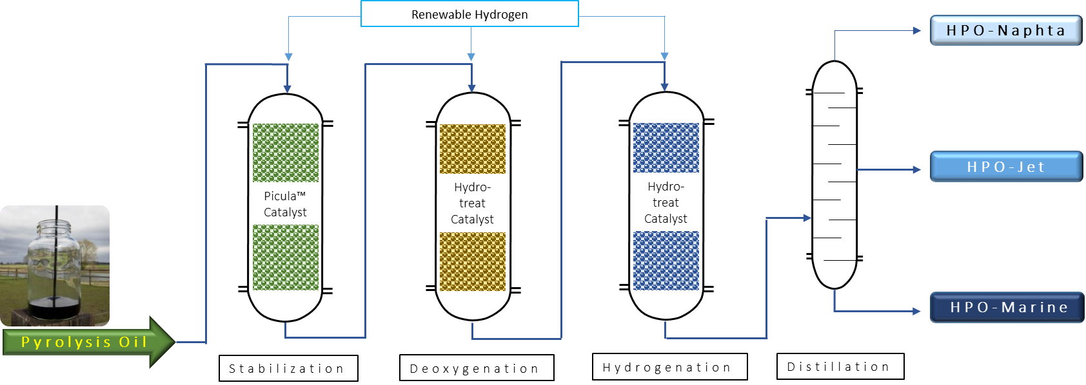
FPBO to advanced biofuels
SPO
SDPO
HPO
SPO = Stabilized Pyrolysis SDPO = Stabilized Deoxygenated Pyrolysis Oil HPO = Hydrotreated Pyrolysis Oil

Slide 11
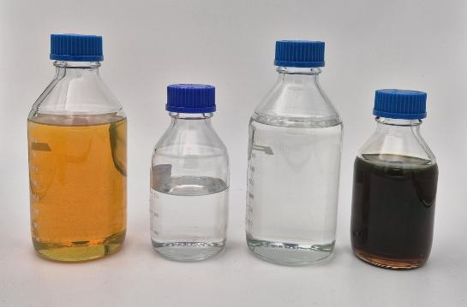


Integration of CC and H2 technologies
HPO
Naphtha
11.9%
JET
52.3%
Marine
34.6%
Both value chains have been successfully demonstrated on pilot scale
Both value chains can in theory benefit from CC/H2 technologies:
CO2 can be captured for boosting gasification yields
Hydrogen is needed for the pyrolysis oil upgrading
Etc..

Slide 12
Overview of technologies for CC(U)S
Doris Matschegg, BEST

Slide 13
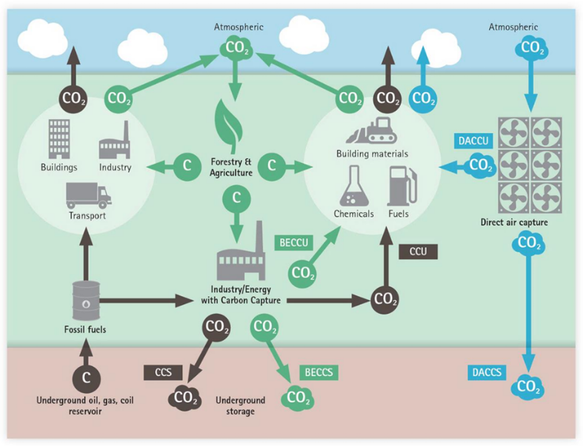
Carbon Capture Utilization and Storage CC(U)S
Carbon capture (utilization) and storage involves the capture, transport, (utilization) or long-term storage of CO₂ from industrial processes.
Since plants absorb CO₂ as they grow, this is one way to remove CO₂ from the atmosphere when capturing from bioenergy technologies.
The BioTheRoS project scope includes:
technologies to capture CO₂ from point sources,
relevant for the combination with biomass gasification or pyrolysis.
→ excludes DACC and pre-combustion technologies
Schematic illustration of BECCS, BECCU, CCS, CCUS, DACCU and DACCS. Source: Austrian Biomass Association

Slide 14
BioTheRoS - CC(US) technology overview
Post-combustion
Pre-combustion
Oxy-fuel combustion
Absorption by chemical solvents
Adsorption by solid sorbents
Membrane separation
Cryogenic separation
Pressure/temperature swing adsorption
Absorption by chemical solvents
Chemical looping
Absorption by physical solvents
Chemical looping reforming
Combustion in pure oxygen
Post combustion technologies
Membrane technologies
Cryogenics
Solid adsorption
Solvent-based absorption
Oxy-fuel combustion technologies
Chemical looping with in-situ conversion

Slide 15
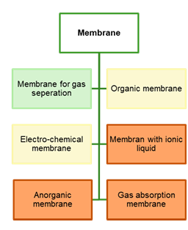
Membrane separation
Membranes separate CO₂ from exhaust emissions by utilizing the partial pressure difference.
These membranes are selected on two key properties:
high selectivity (for a pure product)
high permeability (to accommodate the high flow rate of industrial flue gas)
Membranes can be made from organic material, inorganic material or a hybrid of both.
https://bioenergyeurope.org/wp-content/uploads/2025/06/BECCS-Report_final.pdf
Benefits | Drawbacks
Low energy consumption | Fouling effect
Simple installation | Performance affected by operating conditions

Slide 16
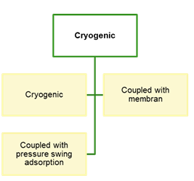
Cryogenics
Cryogenics uses the differences in physical properties to separate CO₂.
Boiling point in cryogenic distillation
Desublimation properties in vapor-solid separation.
https://bioenergyeurope.org/wp-content/uploads/2025/06/BECCS-Report_final.pdf
Benefits | Drawbacks
Used commercially (for high concentration and pressure gases) | High energy demand (cooling)
Results in liquid CO₂ for further use | Flow must be free of water (prevent ice formation)

Slide 17
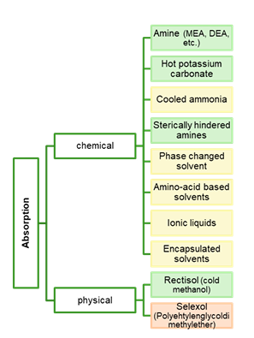
Solvent-based absorption
Solvent-based or chemical absorption uses a chemical solvent to absorb CO₂. The solvent is regenerated by changing the temperature, which separates CO₂ and solvent.
Different chemicals have been tried to achieve the best results, aiming for:
High absorption rate
Large absorption capacity
Low energy requirement for the regeneration of the solvent.
https://bioenergyeurope.org/wp-content/uploads/2025/06/BECCS-Report_final.pdf
Benefits | Drawbacks
Applied worldwide in large scale (MEA – TRL 9) | High equipment corrosion rate
New solvents are being investigated | High energy consumption
 | Environmental impacts due to solvent emissions

Slide 18
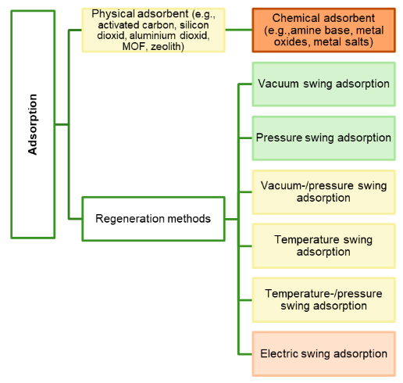
Solid adsorption (PSA/TSA)
Solid adsorption works by adsorbing CO₂ as a thin film on a solid material (e.g., zeolites, activated carbon).
Adsorbent selection according to volume of CO₂, kinetics, pore size, structure, …
By changing the pressure (PSA) or temperature (TSA) the adsorbed CO₂ is released/desorbed.
https://bioenergyeurope.org/wp-content/uploads/2025/06/BECCS-Report_final.pdf
Benefits | Drawbacks
High adsorption capacity | Low CO₂ selectivity
Reversible | Periodic regeneration required

Slide 19
Chemical looping with in-situ conversion (CL-ICCC) Specific adsorption process
Oxy-fuel combustion: An air separator unit separates nitrogen from oxygen prior to combustion – fuel is combusted in an oxygen environment, instead of air.
CO₂ is adsorbed at an active site of a bifunctional material and is then spilled over to the catalytic site of the bifunctional material, where it reacts with a reduction agent into valuable products such as syngas.
Benefits | Drawbacks
Potential to be efficient and comparably low-cost | In development (low TRL)
Combines CO₂ capture and utilization | No retrofitting potential

Slide 20
Overview of technologies for renewable hydrogen production
Patrick Reumerman, BTG

Slide 21
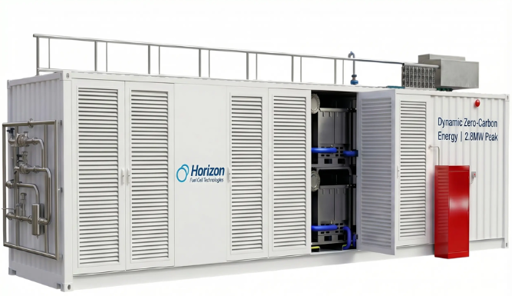
Significance
Both the Gasification and the Pyrolysis value chains can benefit from integration of H2 technologies
Gasification
H2 can be necessary to obtain the right H2:CO ratio
H2 is an important component in the syngas
Pyrolysis
About 5% (wt basis) of hydrogen is needed for upgrading of pyrolysis oil to transport fuels
Boundary conditions:
Hydrogen production should be sustainable (low CO2eq emissions) because of REDII/III requirements
Technologies should be appropriate to the typical scales of gasification and pyrolysis

Slide 22
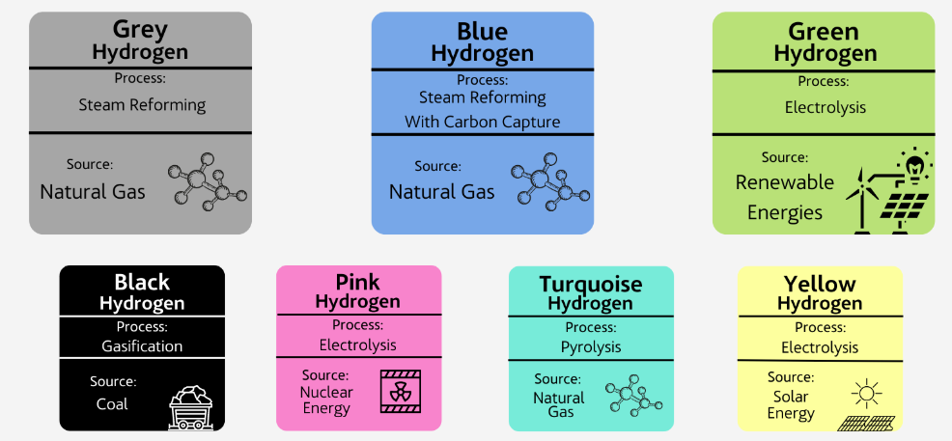
H2 production technologies
Rapid development expected from 0.05 Mtonne/year (2024) in Europe to 14 Mtonne/y (2030) and 55 Mtonne/y (2050)
Typical technologies:
Most common (85%) of global sustainable production is SMR (Steam Methane Reforming) of Natural Gas in combination with Carbon Capture.
“Green hydrogen” can also be produced from Biowaste – though scalabilty is an issue
Electrolysis
Low temperature electrolysis
High temperature electrolysis

Slide 23
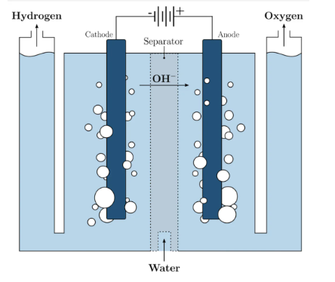
Low temperature electrolysis
Based on the principle of splitting water into hydrogen and oxygen via electricity
Fully commercial (TRL 9), and being scaled up
Several types, based on the way the ions are separated:
PEM (Membrane- separated H+)
AME (Membrane- separated OH-)
AWE (Electrolyte and porous diafragm)
Energetic efficiency is ca 60% - 65%
Key aspects:
Water use and purity is an issue
Can be switched on and off easily → direct coupling with renewable electricity production
Alkaline cell (AWE)

Slide 24
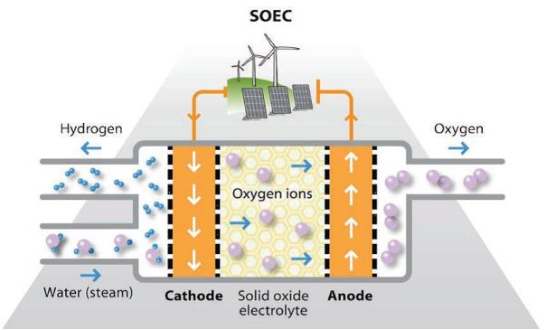
High temperature electrolysis
Based on the principle of splitting water into hydrogen and oxygen using electricity and heat
Not yet fully commercial (TRL 8)
Carried out in Solid Oxide Electrolysis Cells. Ions migrate throug an electrolyte between 500 °C and 1000°C.
Electrical efficiency is ca 75% - 85% - rest is heat.
Key aspects:
Water use and purity is an issue
Promising if a ‘free’ source of high temperature heat is available
Dynamic behaviour is more limited (‘thermal inertia’)

Slide 25
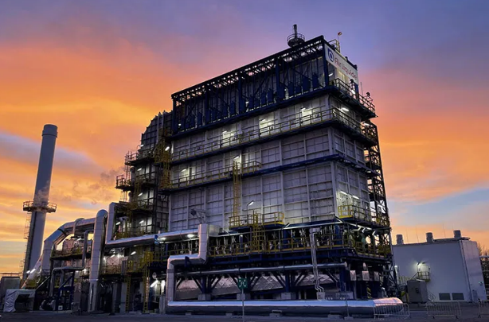
Anaerobic Digestion and SMR
Based on the principle of reacting CH4 with water to to CO and hydrogen, using steam and a catalyst at elevated temperatures (700 – 1000°C)
Fully mature, as it is used also for hydrogen production from natural gas
The AD part – including the CO2 separation from the biogas is also fully mature.
Reasons why it is not implemented more is probably:
Scale (max low-medium scale because of AD limits)
High value of ‘green’ methane
Air Liquide SMR plant in Anwerpen (B)
Key aspects:
Well-suited for pyrolysis upgrading because of the existence of a wastewater stream.

Slide 26
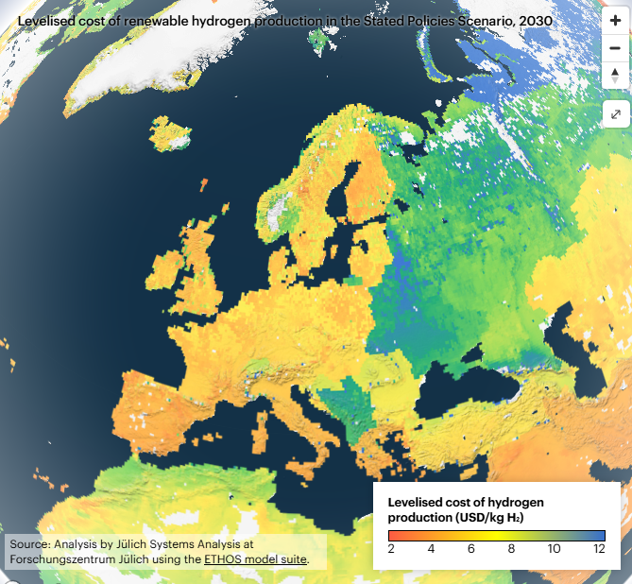
Costs
Costs for hydrogen production from renewable electricity is highly dependent on geographical location – see the IEA Hydrogen production cost tracker map.
Because – in Europe – CAPEX is still a significant factor, overall H2 costs are dependent on operating hours
H2 production using SMR lower, with 3.3 Euro/kg H2, of which the natural gas component is 2.5 Euro/kg H2. This explains the attractiveness of the AD/SMR combination

Slide 27
Summary
Hydrogen production from sustainable sources is limited – but significant scale-up is projected
Low temperature electrolysis remains a dominant technology – but with issues and specific draw-backs
Costs are highly regional, scale- and technology dependent

Slide 28
Linking CC(U)S and hydrogen technologies with gasification
Philipp Graefe, BEST

Slide 29


Basic DFB biomass-to-liquid process chain
Flue gas
Gasifi-cation reactor
Combustion reactor
Coarse and fine gas cleaning
Fischer-Tropsch synthesis
Upgrading
Feedstock
Product Gas
Syngas
Syncrude
CH4
Rest
10%
H2
CO2
H₂O
Air
Impurities (particles, tars, N, S, Cl compounds)
CO
Jet and marine fuel

Slide 30
Basic DFB biomass-to-liquid process chain
FT tail gas composition*
Flue gas
Hydrocarbons
H2
9%
CO
CO2
Gasifi-cation reactor
Combustion reactor
Coarse and fine gas cleaning
Fischer-Tropsch synthesis
Upgrading
Feedstock
Product Gas
Syngas
Syncrude
CH4
Rest
10%
H2
CO2
H₂O
Air
Impurities (particles, tars, N, S, Cl compounds)
CO
Jet and marine fuel
*FT simulation: Fresh gas H2/CO/CO2/CH4 = 41/23/24/10; X_{pp}=65%, Recycle = 50%, S_{CO2}=5%, S_{CH4}=7%

Slide 31
Integration of CO₂ separation and utilization
FT tail gas composition*
Flue gas
Hydrocarbons
H2
CO₂ recycling as gasification agent
15%
14%
CO₂ recycling as gasification agent
CO
CO2
Gasifi-cation reactor
Combustion reactor
Coarse and fine gas cleaning
Fischer-Tropsch synthesis
Upgrading
Feedstock
Product Gas#
Syngas
Syncrude
Rest
H2
CH4
7%
H₂O
Air
CO2
Impurities (particles, tars, N, S, Cl compounds)
CO
Jet and marine fuel
*FT simulation: Fresh gas H2/CO/CO2/CH4 = 41/23/5/10; X_{pp}=65%, Recycle = 50%, S_{CO2}=5%, S_{CH4}=7%
#Examplary gas composition with CO2 as gasification medium

Slide 32
Integration of Tail gas valorization
FT tail gas composition*
Hydrocarbons
Flue gas
9%
CO₂ recycling as gasification agent
CO2
H2
Tail gas (reforming)
CO₂ recycling as gasification agent
CO
Gasifi-cation reactor
Combustion reactor
Coarse and fine gas cleaning
Fischer-Tropsch synthesis
Upgrading
Feedstock
Product Gas#
Syngas
Syncrude
Rest
H2
CH4
7%
H₂O
Air
CO2
Impurities (particles, tars, N, S, Cl compounds)
CO
Jet and marine fuel
*FT simulation: Fresh gas H2/CO/CO2/CH4 = 41/23/5/0; X_{pp}=65%, Recycle = 50%, S_{CO2}=5%, S_{CH4}=7%
#Examplary gas composition with CO2 as gasification medium

Slide 33
Integration of H₂ addition
H₂ to valorize additional CO₂ and provide energy
H₂
H₂ for hydroprocessing
H₂ make-up for excess CO
FT tail gas composition*
CO2
Hydrocarbons
Flue gas
CO₂ recycling as gasification agent
4%
Tail gas (reforming)
CO
H2
CO₂ recycling as gasification agent
Gasifi-cation reactor
Combustion reactor
Coarse and fine gas cleaning
Fischer-Tropsch synthesis
Upgrading
Feedstock
Product Gas#
Syngas
Syncrude
Rest
H2
CH4
7%
H₂O
Air
CO2
Impurities (particles, tars, N, S, Cl compounds)
CO
Jet and marine fuel
*FT simulation: Fresh gas H2/CO/CO2/CH4 = 66/33/1/0; X_{pp}=65%, Recycle = 50%, S_{CO2}=5%, S_{CH4}=7%
#Examplary gas composition with CO2 as gasification medium

Slide 34
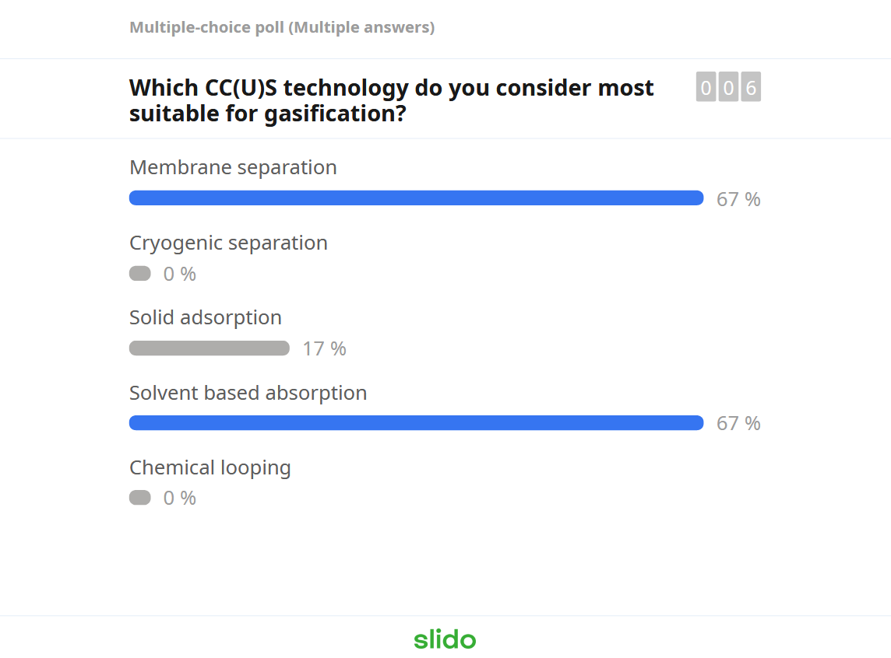

Slide 35
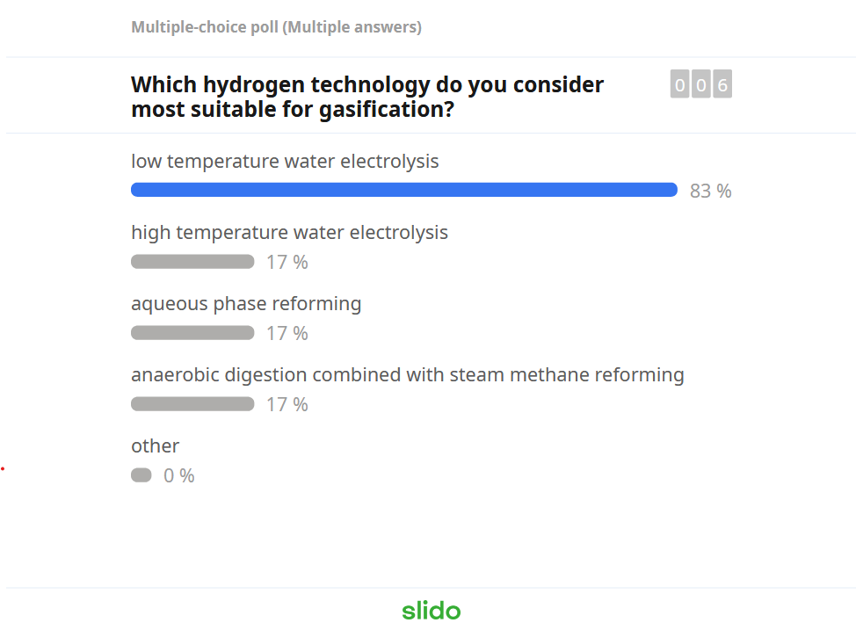

Slide 36
Linking CC(U)S and hydrogen technologies with pyrolysis
Patrick Reumerman, BTG

Slide 37
Pyrolysis value chain
N₂
Purge
Flue gas
H₂
C₁₋C₄
Wastewater
Pyrolysis
Stabilisation and hydrotreatment
Distillation
Naphtha
Feedstock
FPBO
HPO
Bio-jet
Biodiesel
Air
Steam, electricity

Slide 38
CO₂
CO₂
Purge
Flue gas
CCU
H₂
C₁₋C₄
Wastewater
Pyrolysis
Stabilisation and hydrotreatment
Distillation
Naphtha
Feedstock
FPBO
HPO
Bio-jet
Biodiesel
Air
Steam, electricity
Flue gas CO2 can be captured for external use – and as purge gas

Slide 39
CO₂
CO₂
AD/SMR
Purge
Flue gas
CCU
H₂
SMR
C₁₋C₄
Wastewater
Pyrolysis
Stabilisation and hydrotreatment
Distillation
Naphtha
Feedstock
FPBO
HPO
Bio-jet
Biodiesel
Air
Steam, electricity
Hydrogen can be generated from the C1-C4 gases from distillation, and via the organics in the wastewater

Slide 40
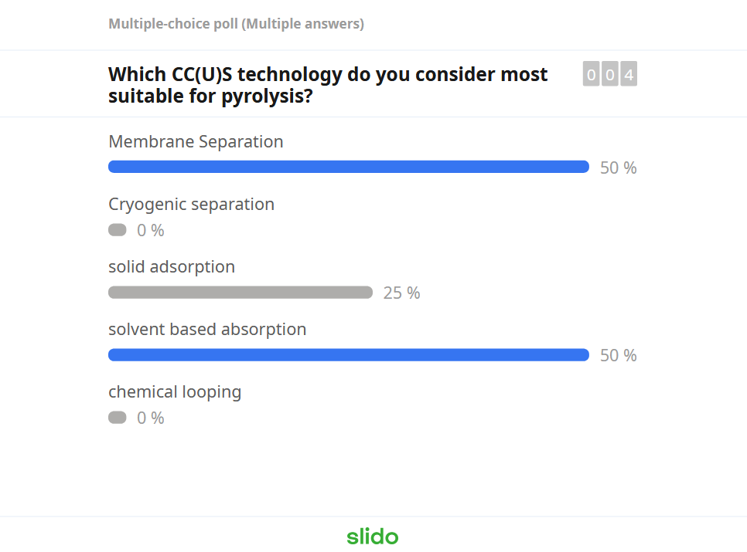

Slide 41
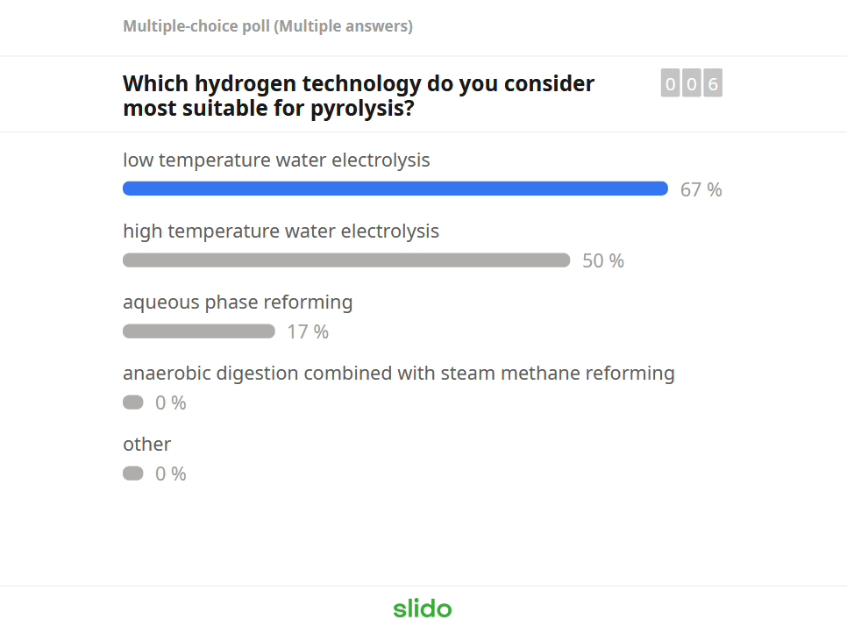

Slide 42
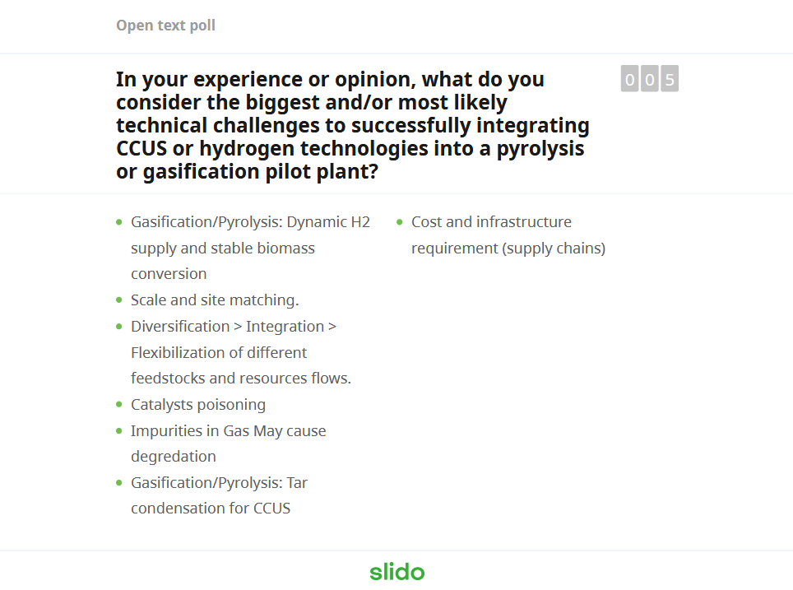

Slide 43

Open discussion

Slide 44
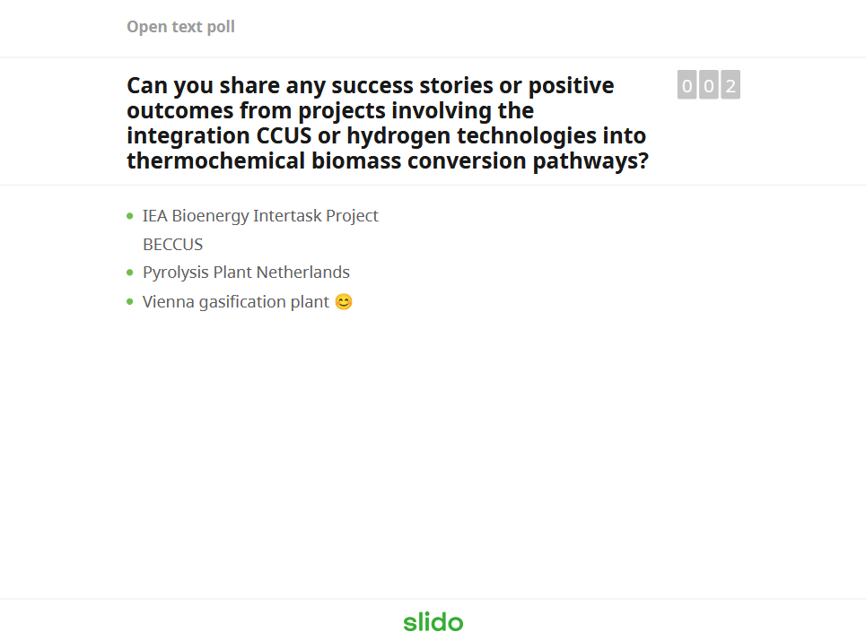

Slide 45

Wrap-up and concluding remarks
Integration of CC(U)S and/or hydrogen technologies in the BioTheRoS value chains:
Gasification
pyrolysis
Next steps: techno-economic evaluation of integration in BioTheRoS value chains
More information, events and publications: https://www.biotheros.eu/en/home/

Slide 46
Thanks for contributing! If you have any more comments or feedback please get in contact:
andrea.sonnleitner@best-research.eu
reumerman@btgworld.com

